Slide 1
UNIT 2
Relational Query Language

Slide 2
Relational Algebra
Relational algebra is a procedural query language that works on relational model. The purpose of a query language is to retrieve data from database or perform various operations such as insert, update, delete on the data. When I say that relational algebra is a procedural query language, it means that it tells what data to be retrieved and how to be retrieved.
On the other hand relational calculus is a non-procedural query language, which means it tells what data to be retrieved but doesn’t tell how to retrieve it.

Slide 3
Types of operations in relational algebra
We have divided these operations in two categories:
1. Basic Operations
2. Derived Operations

Slide 4
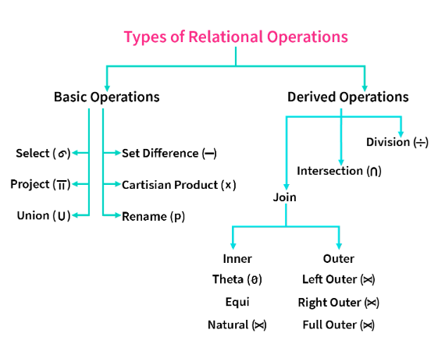

Slide 5
Basic/Fundamental Operations
1. Select (σ)
2. Project (Π)
3. Union (∪)
4. Set Difference (-)
5. Cartesian product (X)
6. Rename (ρ)

Slide 6
Derived Operations
1. Natural Join (⋈)
2. Left, Right, Full outer join (⟕, ⟕, ⟕)
3. Intersection (∩)
4. Division (÷)

Slide 7
Basic Operations

Slide 8
Select Operator (σ)
Select Operator is denoted by sigma (σ) and it is used to find the tuples (or rows) in a relation (or table) which satisfy the given condition.
Syntax of Select Operator (σ)
σ Condition/Predicate(Relation/Table name)

Slide 9
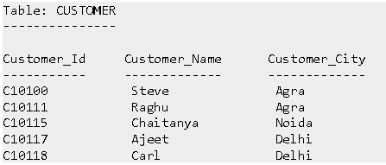
Select Operator (σ) Example

Slide 10
Select a customer who’s city name is “agra”.
Query:
σ Customer_City="Agra" (CUSTOMER)

Slide 11

Output

Slide 12
Project Operator (Π)
Project operator is denoted by Π symbol and it is used to select desired columns (or attributes) from a table (or relation).
Project operator in relational algebra is similar to the Select statement in SQL.
Duplicate entities are eliminated.

Slide 13
Syntax of Project Operator (Π)
Π column_name1, column_name2, ...., column_nameN(table_name)

Slide 14
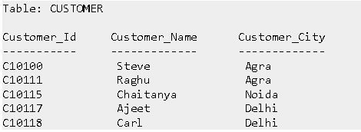
Project Operator (Π) Example
In this example, we have a table CUSTOMER with three columns, we want to fetch only two columns of the table, which we can do with the help of Project Operator Π.

Slide 15
Query
Π Customer_Name, Customer_City (CUSTOMER)

Slide 16
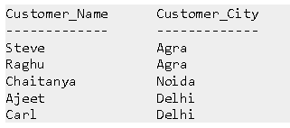
Output

Slide 17
Union Operator ( ∪ )
Union operator is denoted by ∪ symbol and it is used to select all the rows (tuples) from two tables (relations).
Lets discuss union operator a bit more. Lets say we have two relations R1 and R2 both have same columns and we want to select all the tuples(rows) from these relations then we can apply the union operator on these relations.
Note: The rows (tuples) that are present in both the tables will only appear once in the union set. In short you can say that there are no duplicates present after the union operation.

Slide 18
Syntax of Union Operator (∪)
table_name1 ∪ table_name2

Slide 19
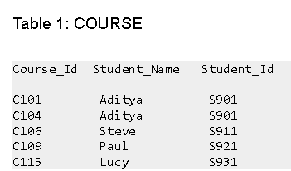
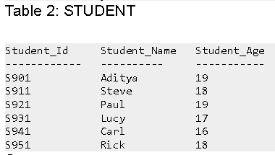
Union Operator (∪) Example

Slide 20
Query
Π Student_Name (COURSE) ∪ Π Student_Name (STUDENT)

Slide 21


Output

Slide 22
Note:
As you can see there are no duplicate names present in the output even though we had few common names in both the tables, also in the COURSE table we had the duplicate name itself.
If relations don't have the same set of attributes, then the union of such relations will result in NULL.

Slide 23
Intersection Operator ( ∩ )
Intersection operator is denoted by ∩ symbol and it is used to select common rows (tuples) from two tables (relations).
Lets say we have two relations R1 and R2 both have same columns and we want to select all those tuples(rows) that are present in both the relations, then in that case we can apply intersection operation on these two relations R1 ∩ R2.
Note: Only those rows that are present in both the tables will appear in the result set.

Slide 24
Syntax of Intersection Operator (∩)
table_name1 ∩ table_name2

Slide 25
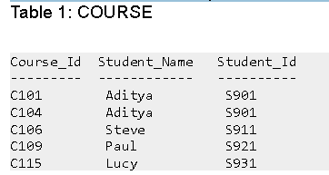
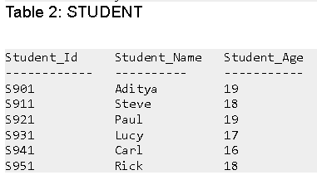
Intersection Operator (∩) Example
Lets take the same example that we have taken above.

Slide 26


Query:
Π Student_Name (COURSE) ∩ Π Student_Name (STUDENT)
Output:

Slide 27
Set Difference (-)
Set Difference is denoted by – symbol. Lets say we have two relations R1 and R2 and we want to select all those tuples(rows) that are present in Relation R1 but not present in Relation R2, this can be done using Set difference R1 – R2.
Syntax of Set Difference (-)
table_name1 - table_name2

Slide 28
Set Difference (-) Example
Lets take the same tables COURSE and STUDENT that we have seen above.
Lets write a query to select those student names that are present in STUDENT table but not present in COURSE table.
Query:
Π Student_Name (STUDENT) - Π Student_Name (COURSE)

Slide 29

Output

Slide 30
Note
Just like union, the set difference also comes with the exception of the same set of attributes in both relations.

Slide 31
Cartesian product (X)
Cartesian Product is denoted by X symbol.
Lets say we have two relations R1 and R2 then the cartesian product of these two relations (R1 X R2) would combine each tuple of first relation R1 with the each tuple of second relation R2.
Syntax of Cartesian product (X)
R1 X R2

Slide 32
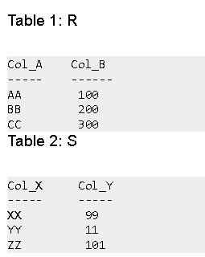
Cartesian product (X) Example

Slide 33
Query:
Lets find the cartesian product of table R and S.
R X S

Slide 34
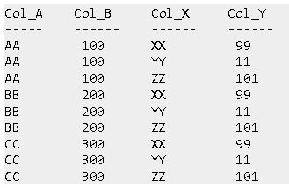
Output

Slide 35
Note
The number of rows in the output will always be the cross product of number of rows in each table. In our example table 1 has 3 rows and table 2 has 3 rows so the output has 3×3 = 9 rows.

Slide 36
Rename (ρ)
Rename (ρ) operation can be used to rename a relation or an attribute of a relation.
Rename operation is denoted by "Rho"(ρ).
Rename (ρ) Syntax:
ρ(new_relation_name, old_relation_name)

Slide 37
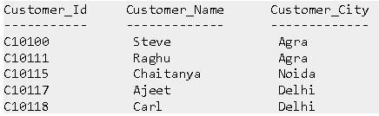
Rename (ρ) Example
Lets say we have a table customer, we are fetching customer names and we are renaming the resulted relation to CUST_NAMES.

Slide 38
Query:
ρ(CUST_NAMES, Π(Customer_Name)(CUSTOMER))

Slide 39
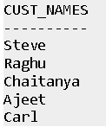
Output

Slide 40
Takeaway
Select (σ) is used to retrieve tuples(rows) based on certain conditions.
Project (∏) is used to retrieve attributes(columns) from the relation.
Union (∪) is used to retrieve all the tuples from two relations.
Set Difference (-) is used to retrieve the tuples which are present in R but not in S(R-S).
Cartesian product (X) is used to combine each tuple from first relation with each tuple from second relation.
Rename (ρ) is used to rename the output relation.

Slide 41
Task
Consider the following schema
Flight( FlightNo: Number, FlightName: String, Source: String, Destination: String)
Display the information of the flights whose FlightNo is greater than 1105.
Display the FlightName for which the Source is London
Display the information of all the flight going (Destination)to Singapore

